Slide 1
Lifestyle Factors Affecting Overall Health
Group 2
Navjit Singh, Nuaym Mubeen, Adam Asadi, Nason Wuo, Anoushka Ali, Mohamed Shirwa

Slide 2
Table of contents
01
02
03
04
Background
Method
Results
Findings & Discussion

Slide 3
Background
Nutritional habits play a significant role in determining long-term health outcomes
Eating behaviors, diet, sleep, exercise, etc.
Understanding the factors that influence these habits is essential for promoting overall health
Wanted to dive deeper in understanding the main factors shaping American nutritional habits

Slide 4
Research Question
Research question:
What are the factors influencing the nutritional habits of Americans?
Targeted audience:
Americans concerned with their well-being.
Why care?
Shaping dietary behaviors can improve your overall health
Does it help solve the problem?
Yes. By comprehensively analyzing the factors influencing Americans’ nutritional habits, we can identify areas for targeted intervention and support.

Slide 5
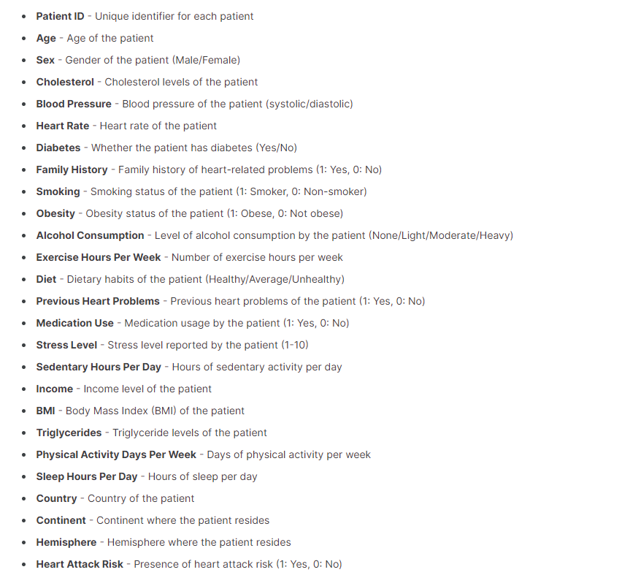
Dataset (Method)
Dataset from Kaggle on heart attack predictions had over 8,700 entries and was extensively varied across different geographies.
We did not utilize other datasets available so as to keep the consistency within our current dataset
Collection of categorical, binary, and continuous variables

Slide 6
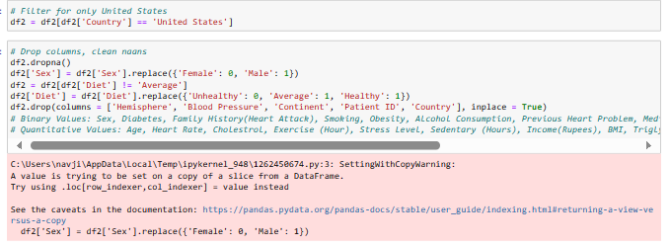
Transformation of Data (Method)
In transforming our dataset we filtered our dataset to just include the population in the United States
We then went on to drop unnecessary factors including: Hemisphere, Blood Pressure, Continent, Patient ID, and Country
These variables were not used to measure health
Converted 'Sex' and 'Diet' columns to binary for analysis, coding 'unhealthy' diet as 0 and 'healthy' as 1, and 'Female' as 0 and 'Male' as 1.
Diet is the ultimate variable to find trends among the other variables

Slide 7
Results

Slide 8
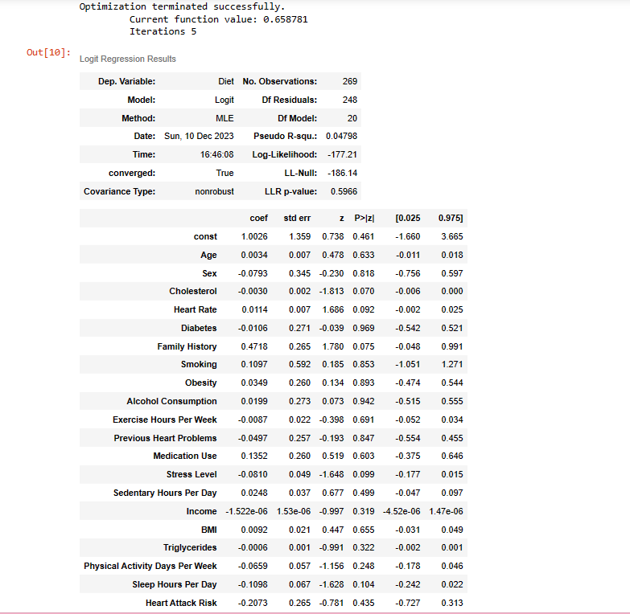
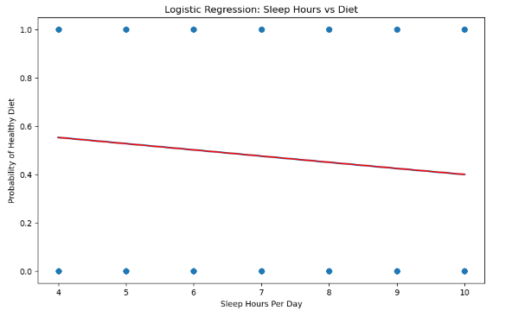
Model 1: Logistic Regression
Logistic regression is a statistical method that helps outline the probability of a binary response based on one or more predictors. Values that are furthest from null have the largest impact
By utilizing Diet as our predictor variable we found the measures of all of the following coefficients involved in our dataset
Highlight: Family history of heart risk, Medication, Smoking
Logistic regression here helps us find which factors thad the most impact
Sleep hours was a factor that was a larger coefficient and was measured to be inverse with health

Slide 9
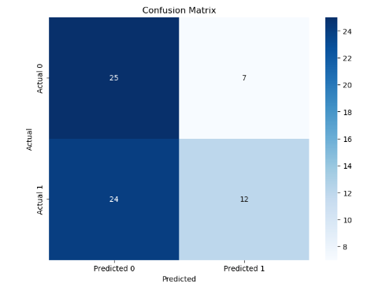
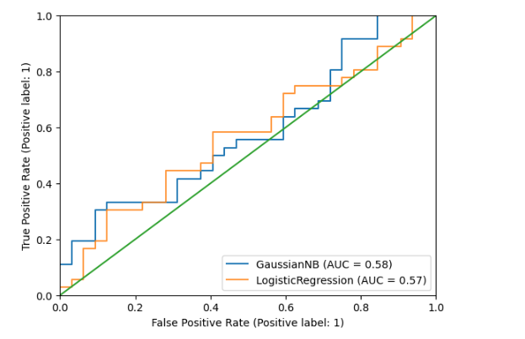
Model 2: Naive Bayes
Naive Bayes can be used for predicting the likelihood of a particular disease based on various feature risks and patient data
During training, the model estimates the prior probabilities of heart attack and no heart attack, as well as the conditional probabilities of each feature given the respective class
The model identifies risk factors by analyzing the conditional probabilities. Features with higher probabilities for a particular class are considered more influential in determining the likelihood of a heart attack
(Stress level, Exercise, Sedentary Hours Per Day, BMI, Smoking, Obesity, Physical Activity)

Slide 10
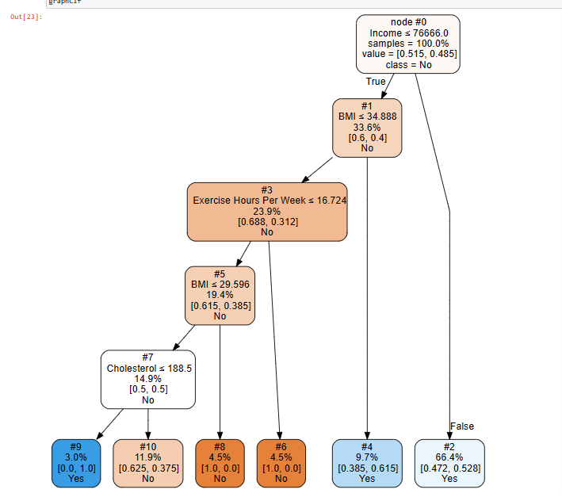
Model 3: Decision Classification Tree
A decision classification tree can effectively determine whether a person's diet is healthy or unhealthy. It navigates through various factors including: BMI, income, exercise, cholesterol at each decision node, ultimately leading to a binary classification of 'healthy' or 'unhealthy' based on these inputs.
The decision tree runs through different factors to determine the likelihood of someone having a specific diet based on metrics found in the dataset

Slide 11
Findings & Discussion

Slide 12
Problems
Our research question shifted based on data that was not readily available online
Our target demographic shifted from adolescents to people just in the United States
Datasets not readily available for nutrition habits
We utilized heart attack risk datasets in uncovering hidden trends in our dataset
In the future we would need more readily available data to streamline through our code to provide a more accurate finding in which factors have greater effect on different demographics’ dietary habits.

Slide 13
Findings
Highlighting Most Impactful Variables on Overall Health
Family History
Smoking
Stress Level
Medication Use
Sleep Hours Per Day
Highlighting Least Impactful Variables on Overall Health
Income
BMI
Cholesterol
Age
Alcohol

Slide 14
Discussion
Government and Healthcare Authorities:
Promote Health Awareness: Focus on family health histories in preventive healthcare campaigns.
Anti-Smoking Initiatives: Implement stricter regulations and awareness programs targeting smoking.
Stress Management Programs: Invest in mental health support systems and stress reduction initiatives.
Educational Institutes:
Health Education Programs: Include modules on the impact of lifestyle choices (smoking, sleep, stress) on overall health.
Supportive Environments: Create conducive environments for stress reduction and promote healthy habits.
Corporations:
Workplace Wellness Programs: Incorporate initiatives to reduce stress, promote work-life balance, and discourage smoking.
Supportive Policies: Offer flexible work schedules to accommodate healthy lifestyle choices.
Individuals (Adults, Students, Parents):
Lifestyle Modifications: Encourage healthy habits, emphasize the importance of adequate sleep and stress management.
Regular Health Check-ups: Encourage monitoring family health history and seeking timely medical advice.

Slide 15
Conclusion
In conclusion, the data highlights the substantial impact of key factors like Family History, Smoking, Stress Level, Medication Use, and Sleep Hours Per Day on overall health outcomes. Implementing the recommendations derived from these findings holds potential in preventing future health complications and improving well-being. Understanding dietary habits during adolescence is pivotal, as they persist into adulthood, shaping lifelong health outcomes. Further research into cultural influences, individual behaviors, and regional variations in overall nutrition is imperative. Targeted interventions, cultural awareness, and policy changes offer an opportunity to shape overall healthier behaviors, ensuring a healthier future for generations to come.

Slide 16
Thank You

